Slide 1
Welcome
Bismilllahhir Rahmanir Rahim
Hosted and prepared by
MD. SOROWAR MAHABUB RABBY
Department of CSE (Computer Science and Engineering) , IIUC
Cell: 01834756433, 01521564157
E-mail: sorowarmahabub1709vip@gmail.com

Slide 2
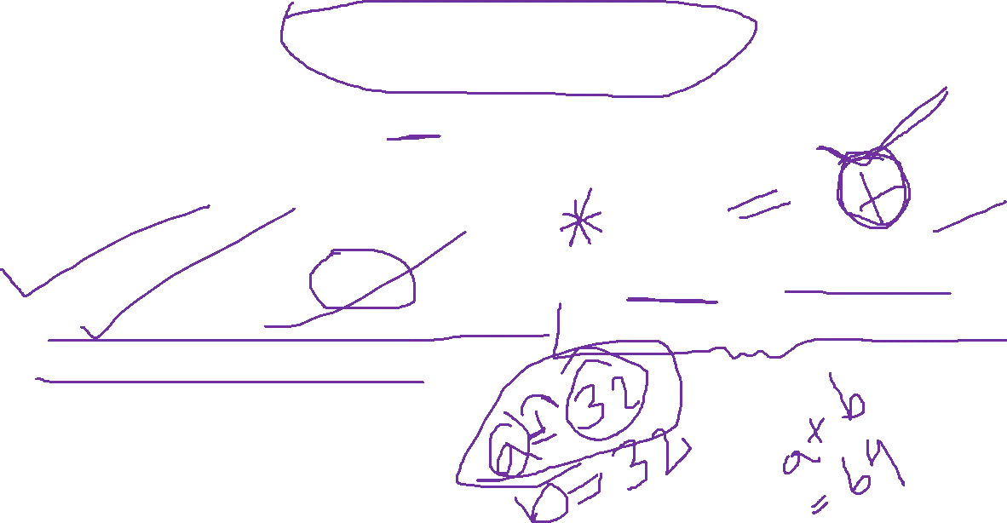
Operators in C Language
An operator is a symbol that tells the compiler to perform a certain mathematical or logical manipulation. Operators are used in programs to manipulate data and variables.

Slide 3

Operators in C Language
C operators can be classified into following types:
Arithmetic operators
Relational operators
Logical operators
Bitwise operators
Assignment operators
Conditional operators
Special operators

Slide 4
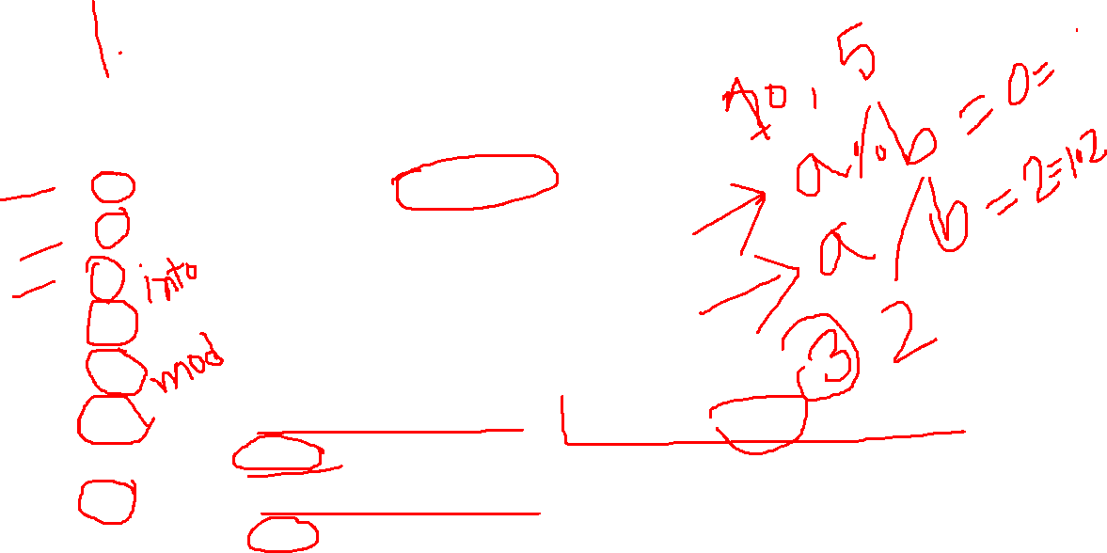
Arithmetic operators
Operator | Description
+ | adds two operands
- | subtract second operands from first
* | multiply two operand
/ | divide numerator by denominator
% | remainder of division
++ | Increment operator - increases integer value by one
-- | Decrement operator - decreases integer value by one

Slide 5
++ | Increment operator increases the integer value by one. | A++ = 11
-- | Decrement operator decreases the integer value by one. | A-- = 9

Slide 6
Relational operators
Operator | Description
== | Check if two operand are equal
!= | Check if two operand are not equal.
> | Check if operand on the left is greater than operand on the right
< | Check operand on the left is smaller than right operand
>= | check left operand is greater than or equal to right operand
<= | Check if operand on left is smaller than or equal to right operand

Slide 7
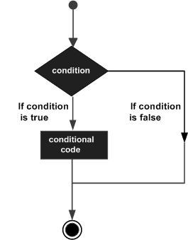
This is How if condition works

Slide 8
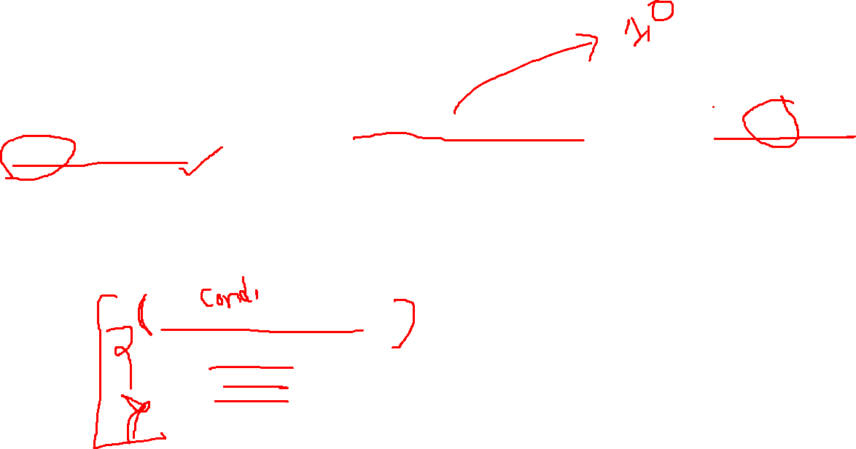
if statement
An if statement consists of a Boolean expression followed by one or more statements.
Syntax
The syntax of an 'if' statement in C programming language is −
if(boolean_expression)
{
/* statement(s) will execute if the
boolean expression is true */
}

Slide 9
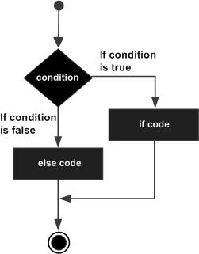
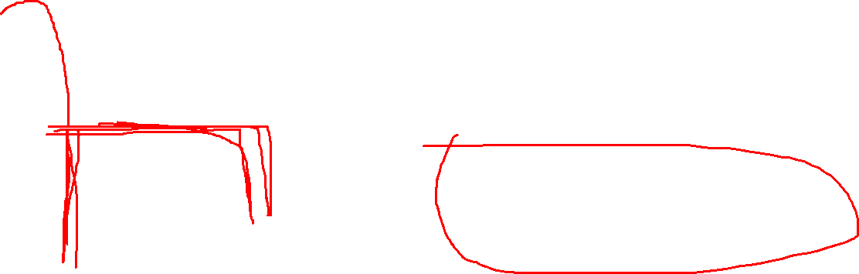
This is How if else condition works

Slide 10

if...else statement
An if statement can be followed by an optional else statement, which executes when the Boolean expression is false.
Syntax
The syntax of an if...else statement in C programming language is −
if(boolean_expression) {
/* statement(s) will execute if the boolean expression is true */
}
else {
/* statement(s) will execute if the boolean expression is false */
}

Slide 11
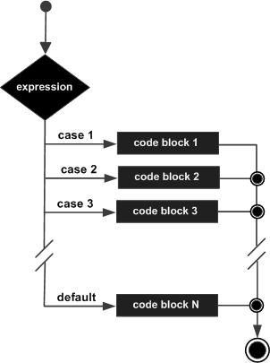
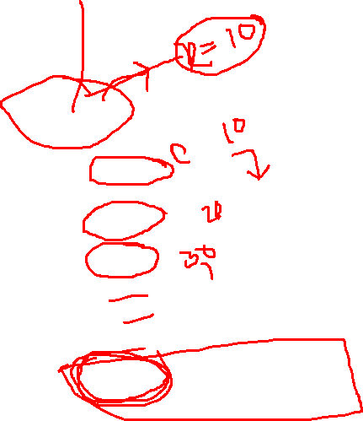
This is How switch condition works

Slide 12
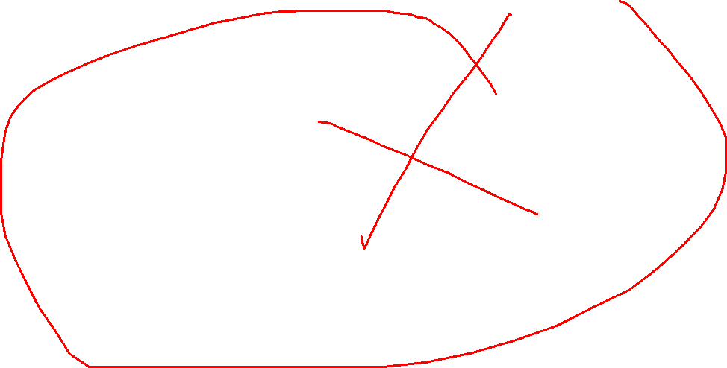
Switch statement
switch(expression)
{
case constant-expression :
statement(s);
break; /* optional */
case constant-expression :
statement(s);
break; /* optional */
/* you can have any number of case statements */ default : /* Optional */
statement(s);
}
Syntax
The syntax for a switch statement in C programming language is as follows −

Slide 13
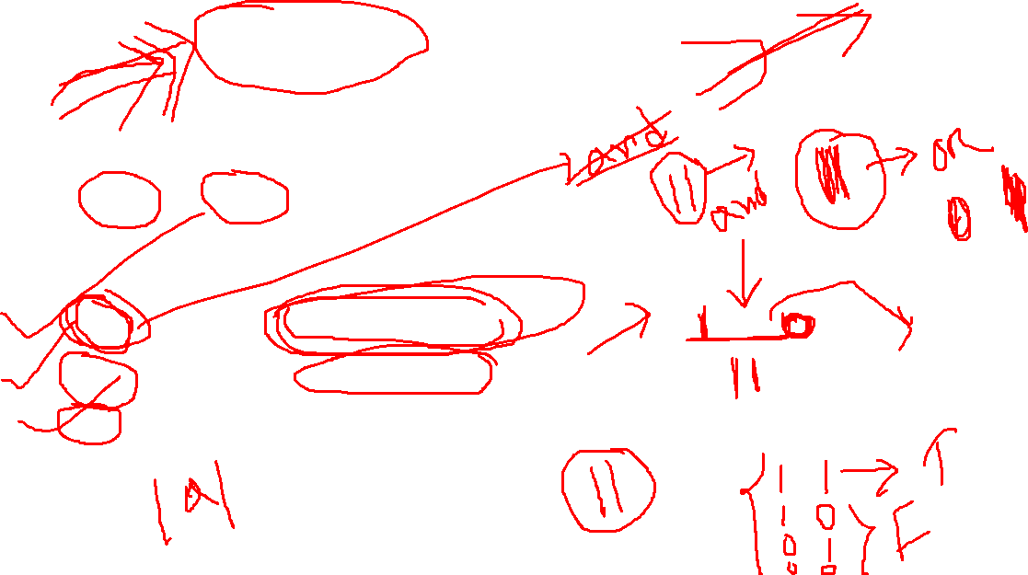
Logical operator
C language supports following 3 logical operators.
Suppose a = 1 and b = 0,
Operator | Description | Example | Ans
&& | Logical AND | (a && b) | false
|| | Logical OR | (a || b) | true
! | Logical NOT | (!a) | false

Slide 14
Bitwise operators
Bitwise operators perform manipulations of data at bit level. These operators also perform shifting of bits from right to left. Bitwise operators are not applied to float or double.
Operator | Description
& | Bitwise AND
| | Bitwise OR
^ | Bitwise exclusive OR
<< | left shift
>> | right shift
Example :
a = 00011000
b = 3
a << b = 1100000
a >> b = 0000011

Slide 15
Assignment Operators
Operator | Description | Example
= | assigns values from right side operands to left side operand | a=b
+= | adds right operand to the left operand and assign the result to left | a+=b is same as a=a+b
-= | subtracts right operand from the left operand and assign the result to left operand | a-=b is same as a=a-b
*= | mutiply left operand with the right operand and assign the result to left operand | a*=b is same as a=a*b
/= | divides left operand with the right operand and assign the result to left operand | a/=b is same as a=a/b
%= | calculate modulus using two operands and assign the result to left operand | a%=b is same as a=a%b

Slide 16
Conditional operator
It is actually the if condition that we use in C language decision making, but using conditional operator, we turn the if condition statement into a short and simple operator.
The syntax of a conditional operator is :
expression 1 ? expression 2: expression 3
Explanation:
The question mark "?" in the syntax represents the if part.
The first expression (expression 1) generally returns either true or false, based on which it is decided whether (expression 2) will be executed or (expression 3)
If (expression 1) returns true then the expression on the left side of " : " i.e (expression 2) is executed.
If (expression 1) returns false then the expression on the right side of " : " i.e (expression 3) is executed.

Slide 17
Special Operator
Operator | Description | Example
sizeof | Returns the size of an variable | sizeof(x) return size of the variable x
& | Returns the address of an variable | &x ; return address of the variable x
* | Pointer to a variable | *x ; will be pointer to a variable x

Slide 18
Operators Precedence in C
Category | Operator | Associativity
Postfix | () [] -> . ++ - - | Left to right
Unary | + - ! ~ ++ - - (type)* & sizeof | Right to left
Multiplicative | * / % | Left to right
Additive | + - | Left to right
Shift | << >> | Left to right
Relational | < <= > >= | Left to right
Equality | == != | Left to right
Bitwise AND | & | Left to right
Category | Operator | Associativity
Bitwise XOR | ^ | Left to right
Bitwise OR | | | Left to right
Logical AND | && | Left to right
Logical OR | || | Left to right
Conditional | ?: | Right to left
Assignment | = += -= *= /= %=>>= <<= &= ^= |= | Right to left
Comma | , | Left to right

Slide 19
Kocu, Hahahaha
Any questions?

Slide 20
পারবা ……? Chat এ লিখে পেল দ্রুত!
যেকোনো ৮ টা অপারেটর এর নাম লিখতে পারবা (শুধু চিহ্ন লিখলে হবে!)
…………....?

Slide 21

Thanks
(Jajakallah Khairan)

